Slide 1
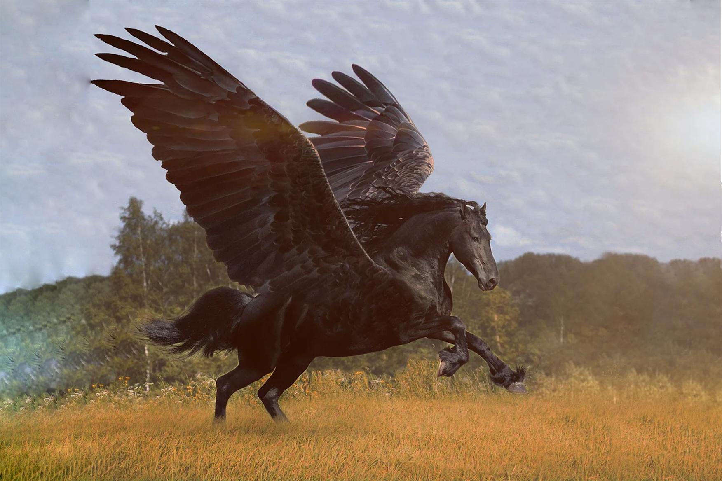
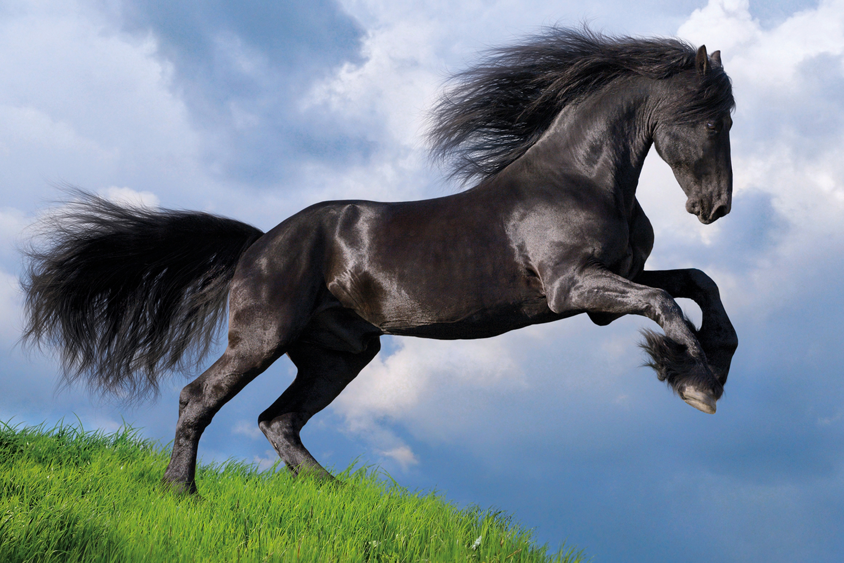
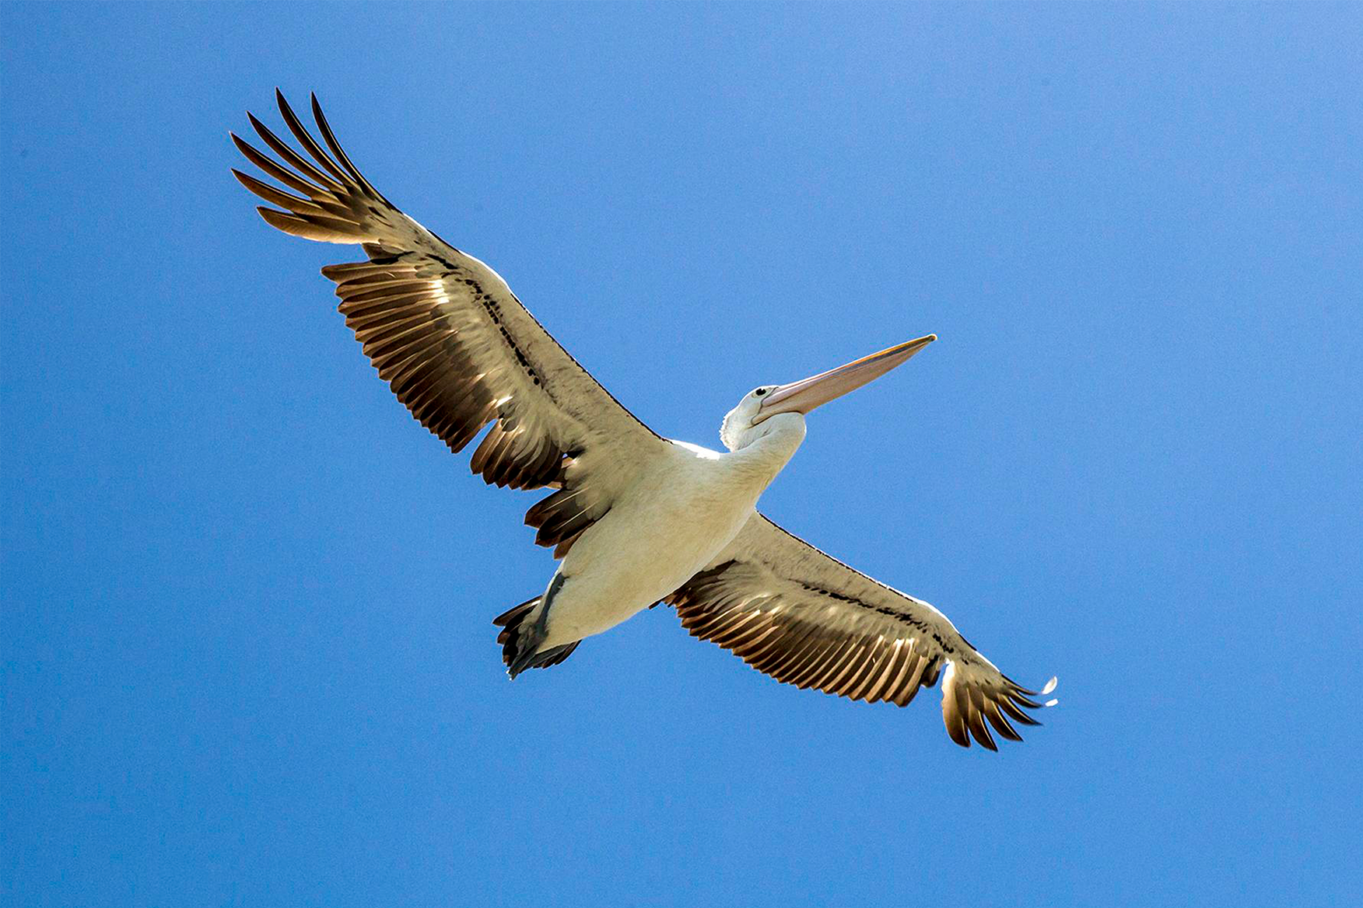
Zero-Shot Learning: Towards the Effortless Classification of Mystical Creatures
?
Max Woolterton, department of natural sciences, durham university
Notes:
Hello I am Max Woolterton, I am a natural scientist at durham university, undertaking a third year project within the department of computer science.
Today I am going to be giving an overview of the context, background and motivation of the project, followed by a demonstration and evaluation of the project and what was achieved.
My project title Is Combining Recent Advances in Reinforcement Learning. Specifically, I am investigating the design and creation of an intelligent agent capable of teaching itself to play the game Super Mario Bros, at varying levels of increasing difficulty. This is achieved via the combination of many recent state-of-the-art contributions to the field of Reinforcement Learning.

Slide 2
What is Zero - shot Learning ?
Notes:
This is additionally what sets apart this project from all of the other approaches, as there are six years worth of state of the art research that have yet to be applied to this field.

Slide 3
?

Slide 4
A Pegasus:
?

Slide 5
A Pegasus:
A flying horse, with large, plumed wings.

Slide 6
A Pegasus:
can fly
horse-like
has wings
large wing-span
plumed wings
bird-like.

Slide 7
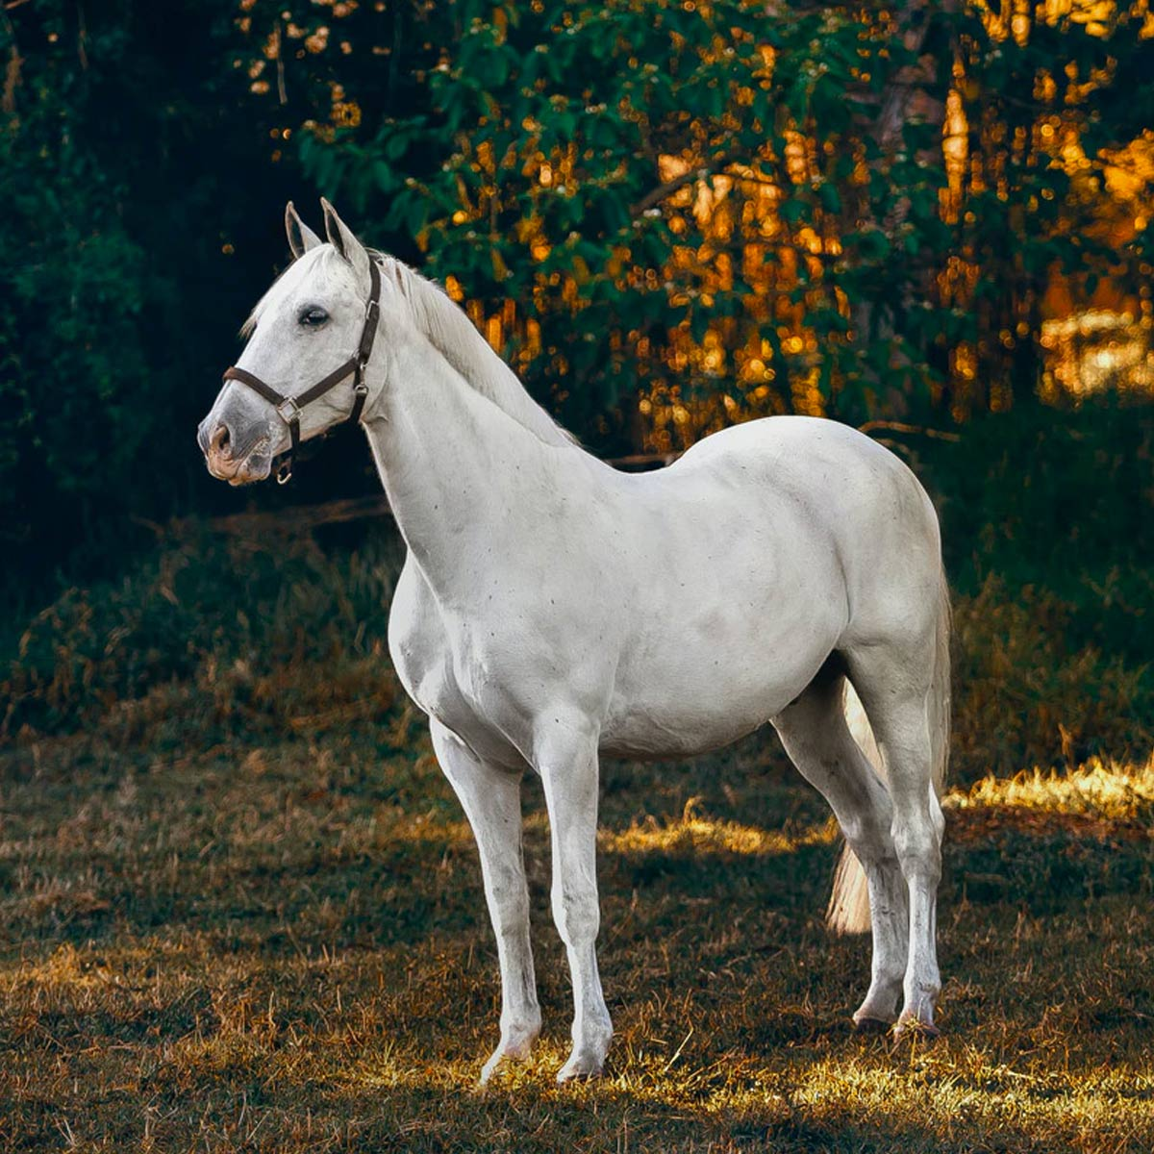
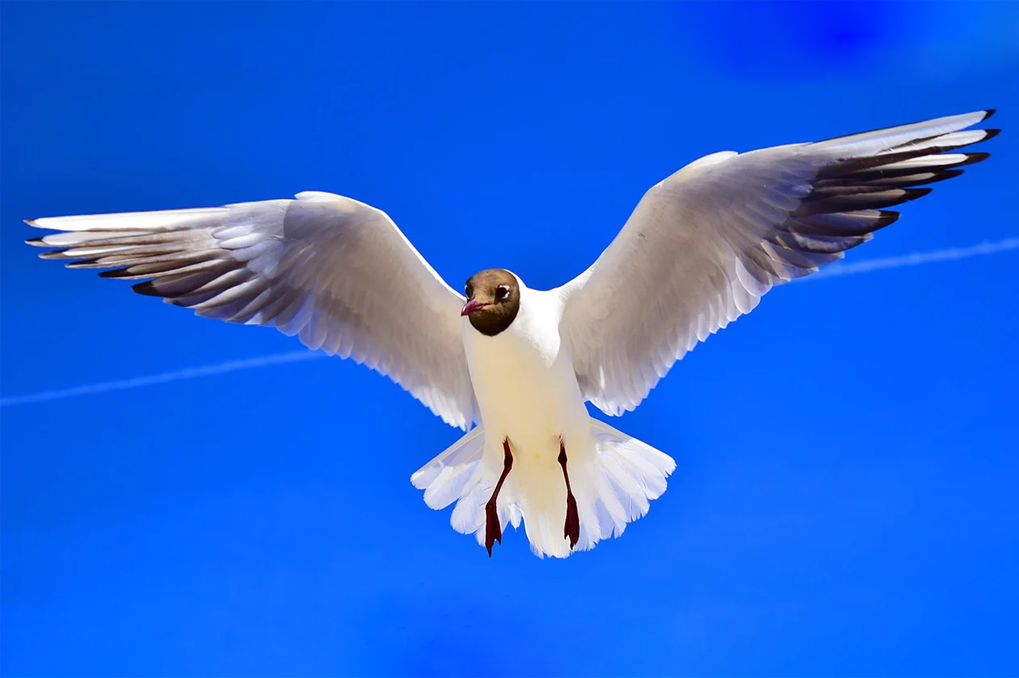

Slide 8
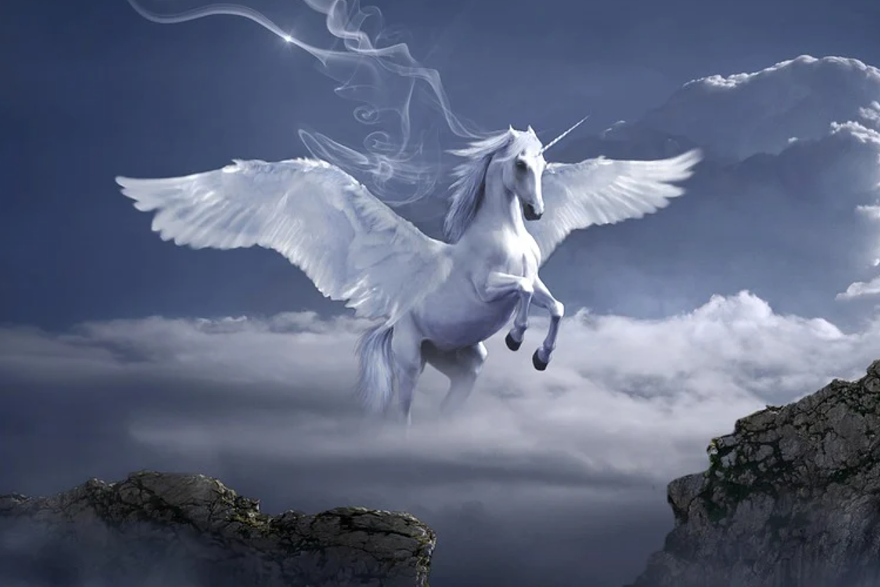
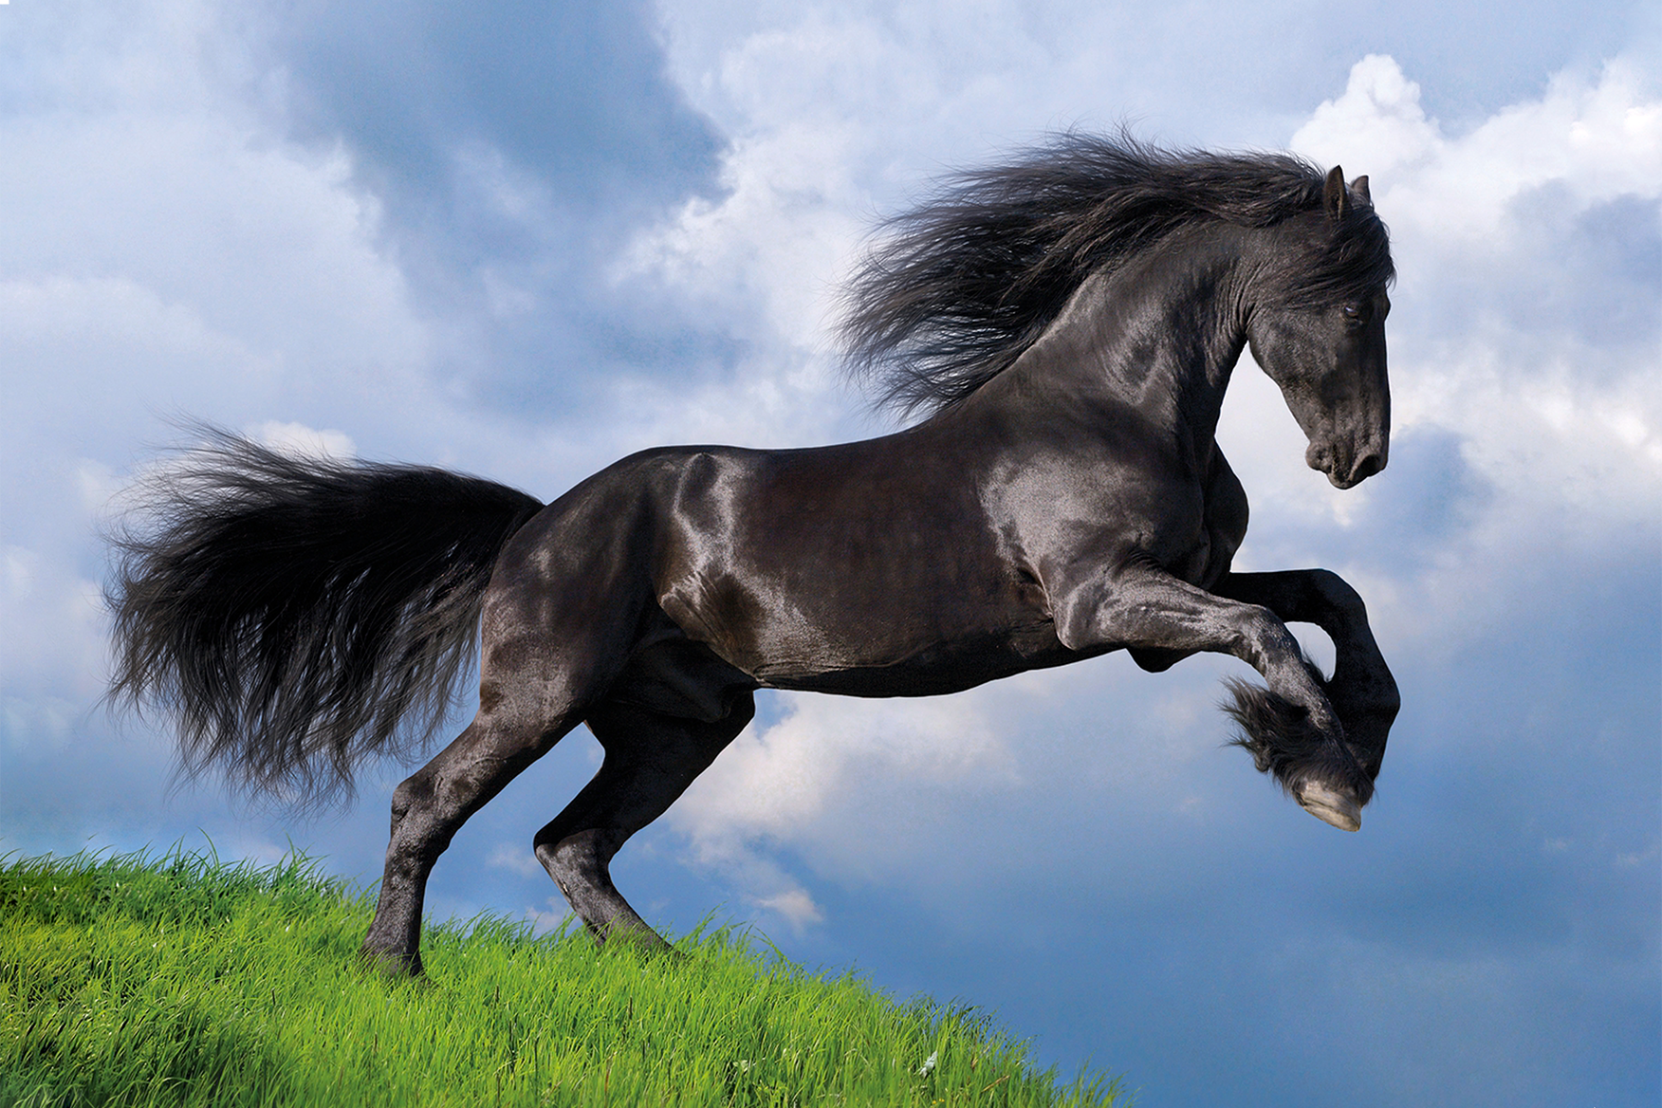
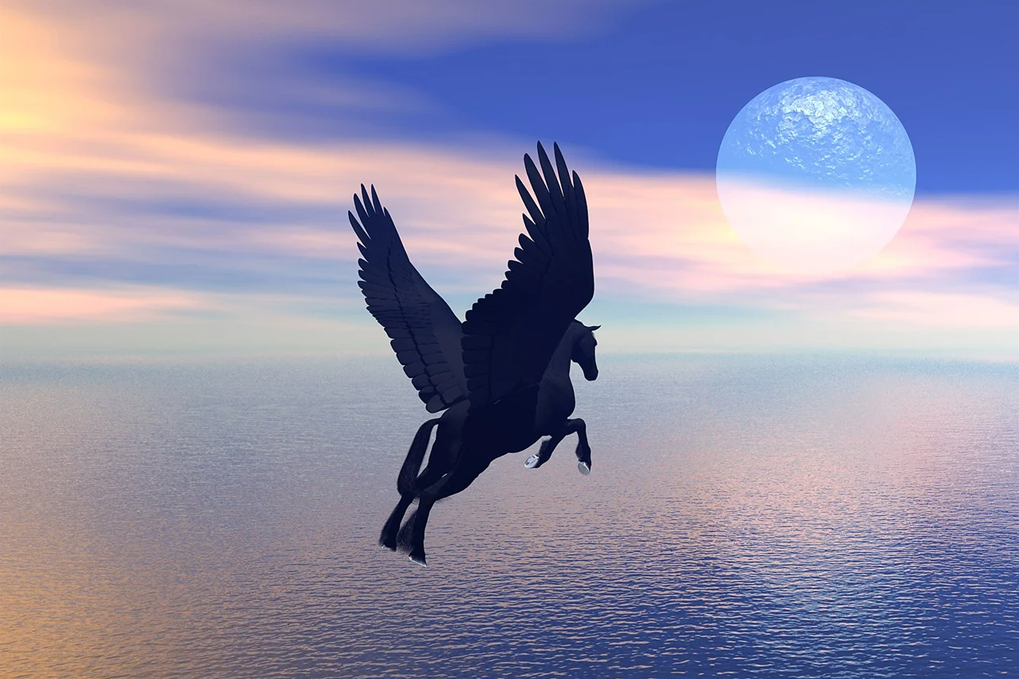

Slide 9
The Problem:
In traditional Image Classification:
A new (large + balanced) dataset of Pegasi would be required
The whole model would have to be retrained
Both of these are expensive and time-consuming
Notes:
This is additionally what sets apart this project from all of the other approaches, as there are six years worth of state of the art research that have yet to be applied to this field.

Slide 10
The solution: zero - shot learning.
Notes:
This is additionally what sets apart this project from all of the other approaches, as there are six years worth of state of the art research that have yet to be applied to this field.

Slide 11
How does zero-shot learning achieve this?
Notes:
This is additionally what sets apart this project from all of the other approaches, as there are six years worth of state of the art research that have yet to be applied to this field.

Slide 12
How does Zero-shot Learning achieve this?
> Transfers knowledge gained about “seen classes” during training onto the novel “unseen classes” introduced at test-time.
> How: using auxiliary / side data-sources.
> Which must: contain semantic information about classes.
> For example: hand-annotated class-attributes, word-embeddings, knowledge graphs..
Notes:
The goal of this project is to design and create an intelligent agent using machine learning which, when trained on a training set consisting of multiple levels, is capable of consistently completing the majority of them.
To do so we will be attempting to combine some of the latest state of the art techniques and algorithms from reinforcement learning into a single agent. Simultaneously, we will be trying to work out how best to combine these components, as not all algorithms are compatible nor are their benefits necessarily orthogonal.
After this agent has been made, the final task in the project is to analyze the agent and its ability to learn, by breaking down its performance into that provided by each of its constituent parts via extensive ablation studies.

Slide 13
Our SOLUTION
Notes:
This is additionally what sets apart this project from all of the other approaches, as there are six years worth of state of the art research that have yet to be applied to this field.

Slide 14
The evolution of our Solution:
WordNet (1995) [2]
GCN (2016) [1]
ResNets (2015) [6]
GCNZ (2018) [3]
Notes:
R2D4+ stands for Recurrent Replay Deeper Denser Distributed DQN+ The dashed line here represents an inheritance that does not flow all the way to our solution, as instead of deciding to make our solution distributional using C51 as Rainbow does, we decided to instead use the much improved IQN algorithm.

Slide 15
The evolution of our Solution:
WordNet (1995) [2]
GCN (2016) [1]
ResNets (2015) [6]
GCNZ (2018) [3]
DGP & SGCN (2019) [4]
ZSL-KG (2021) [5]
ConceptNet (2017) [8]
Notes:
R2D4+ stands for Recurrent Replay Deeper Denser Distributed DQN+ The dashed line here represents an inheritance that does not flow all the way to our solution, as instead of deciding to make our solution distributional using C51 as Rainbow does, we decided to instead use the much improved IQN algorithm.

Slide 16
The evolution of our Solution:
WordNet (1995) [2]
GCN (2016) [1]
ResNets (2015) [6]
GCNZ (2018) [3]
DGP & SGCN (2019) [4]
EfficientNets (2019) [7]
ZSL-KG (2021) [5]
ConceptNet (2017) [8]
Notes:
R2D4+ stands for Recurrent Replay Deeper Denser Distributed DQN+ The dashed line here represents an inheritance that does not flow all the way to our solution, as instead of deciding to make our solution distributional using C51 as Rainbow does, we decided to instead use the much improved IQN algorithm.

Slide 17
Our Solution: ZSL-KG+
WordNet (1995) [2]
GCN (2016) [1]
ResNets (2015) [6]
GCNZ (2018) [3]
DGP & SGCN (2019) [4]
GradCAM (2017) [9]
EfficientNets (2019) [7]
ZSL-KG (2021) [5]
ConceptNet (2017) [8]
ZSL-KG+
(Our solution)
Notes:
R2D4+ stands for Recurrent Replay Deeper Denser Distributed DQN+ The dashed line here represents an inheritance that does not flow all the way to our solution, as instead of deciding to make our solution distributional using C51 as Rainbow does, we decided to instead use the much improved IQN algorithm.

Slide 18
Our Solution: ZSL-KG+
WordNet (1995) [2]
GCN (2016) [1]
ResNets (2015) [6]
GCNZ (2018) [3]
DGP & SGCN (2019) [4]
GradCAM (2017) [9]
EfficientNets (2019) [7]
ZSL-KG (2021) [5]
ConceptNet (2017) [8]
Knowledge
Graphs
=
ConvNets
=
=
ZSL-KG+
(Our solution)
ZSL
Other
=
Notes:
R2D4+ stands for Recurrent Replay Deeper Denser Distributed DQN+ The dashed line here represents an inheritance that does not flow all the way to our solution, as instead of deciding to make our solution distributional using C51 as Rainbow does, we decided to instead use the much improved IQN algorithm.

Slide 19
Size comparison:
Attribute-based ZSL
WordNet (1995) [2]
GCN (2016) [1]
ResNets (2015) [6]
DGP & SGCN (2019) [4]
GCNZ (2018) [3]
EfficientNets (2019) [7]
GradCAM (2017) [9]
ZSL-KG (2021) [5]
ConceptNet (2017) [8]
ZSL-KG+
(Our solution)
Notes:
R2D4+ stands for Recurrent Replay Deeper Denser Distributed DQN+ The dashed line here represents an inheritance that does not flow all the way to our solution, as instead of deciding to make our solution distributional using C51 as Rainbow does, we decided to instead use the much improved IQN algorithm.

Slide 20
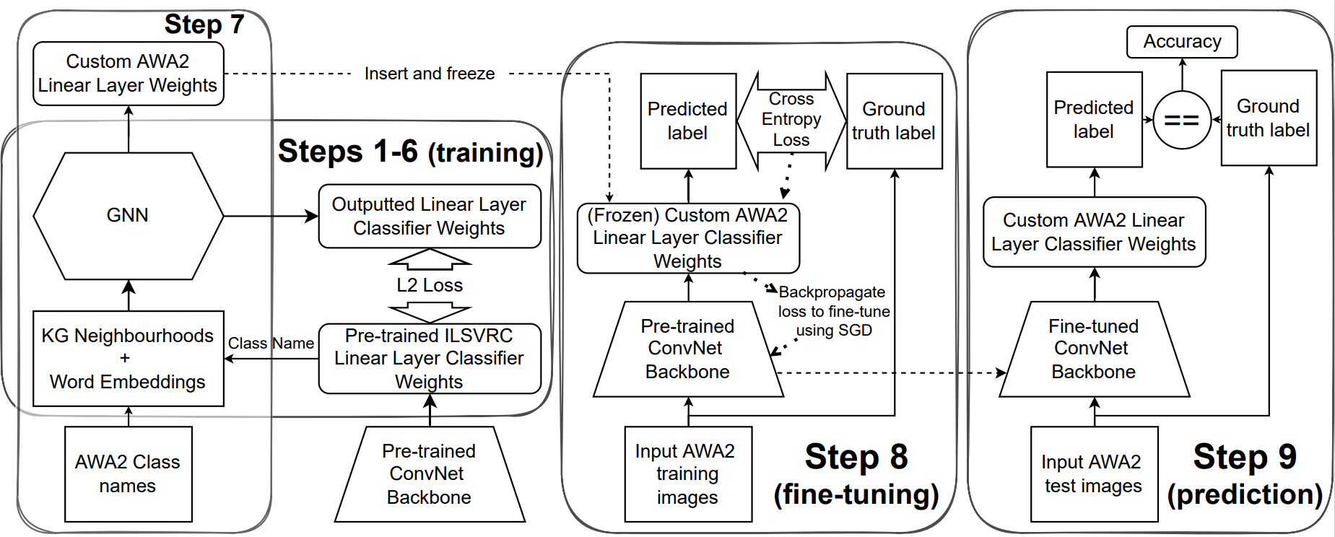
OUR architecture
Notes:
Our QNetwork is composed of a convolutional stack leading into an LSTM followed up a dueling architecture of noisy linear layers.
This network takes as an input a stack of 4 gray scale frames taken directly from super mario bros alongside the previous action reward, and outputs a q-value estimate for each possible action from the current state.

Slide 21


OUR architecture
$$GNN :(G_{graph},u_{label}) \overset{→}{ } u_{classifier}$$
$$u_{classifier} :I_{image} \overset{→}{ } u_{predicted_label}$$
Notes:
Our QNetwork is composed of a convolutional stack leading into an LSTM followed up a dueling architecture of noisy linear layers.
This network takes as an input a stack of 4 gray scale frames taken directly from super mario bros alongside the previous action reward, and outputs a q-value estimate for each possible action from the current state.

Slide 22
OUR architecture
Notes:
Our QNetwork is composed of a convolutional stack leading into an LSTM followed up a dueling architecture of noisy linear layers.
This network takes as an input a stack of 4 gray scale frames taken directly from super mario bros alongside the previous action reward, and outputs a q-value estimate for each possible action from the current state.

Slide 23

OUR architecture
$$ℒ=\sum_{u}{\sum_{i}{{\left(W_{u,i}^{ConvNet}−\text{GNN}{\left(u, G, W^{GNN}\right)}_{i}\right)}^{2}}}$$
Notes:
Our QNetwork is composed of a convolutional stack leading into an LSTM followed up a dueling architecture of noisy linear layers.
This network takes as an input a stack of 4 gray scale frames taken directly from super mario bros alongside the previous action reward, and outputs a q-value estimate for each possible action from the current state.

Slide 24
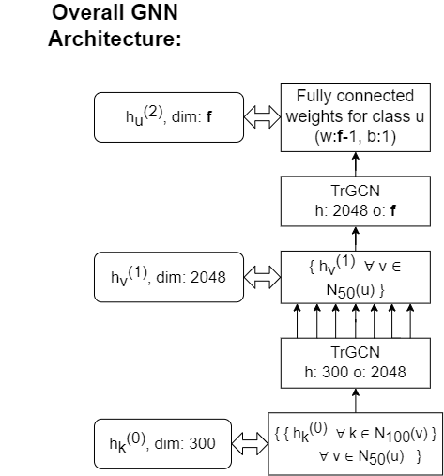
Graph neural network (GNN) architecture
Word-embeddings
Notes:
Our QNetwork is composed of a convolutional stack leading into an LSTM followed up a dueling architecture of noisy linear layers.
This network takes as an input a stack of 4 gray scale frames taken directly from super mario bros alongside the previous action reward, and outputs a q-value estimate for each possible action from the current state.

Slide 25

Graph neural network (GNN) architecture
$$\text{GNN}\left(u, G, W\right)=$$
$$\text{TrGCN}(W_{1}, \{ h_{v}(1) ∀ v ∈ N50(u) \})$$
Word-embeddings
Notes:
Our QNetwork is composed of a convolutional stack leading into an LSTM followed up a dueling architecture of noisy linear layers.
This network takes as an input a stack of 4 gray scale frames taken directly from super mario bros alongside the previous action reward, and outputs a q-value estimate for each possible action from the current state.

Slide 26

Graph neural network (GNN) architecture
$$\text{GNN}\left(u, G, W\right)=$$
$$\text{TrGCN}(W_{1}, \{ h_{v}(1) ∀ v ∈ N50(u) \})$$
$$h_{v}^{(1)}=\text{TrGCN}(W_{0}, \left\{ h_{k}\left(0\right) ∀ k ∈ N100\left(v\right) \right\})$$
Word-embeddings
Notes:
Our QNetwork is composed of a convolutional stack leading into an LSTM followed up a dueling architecture of noisy linear layers.
This network takes as an input a stack of 4 gray scale frames taken directly from super mario bros alongside the previous action reward, and outputs a q-value estimate for each possible action from the current state.

Slide 27
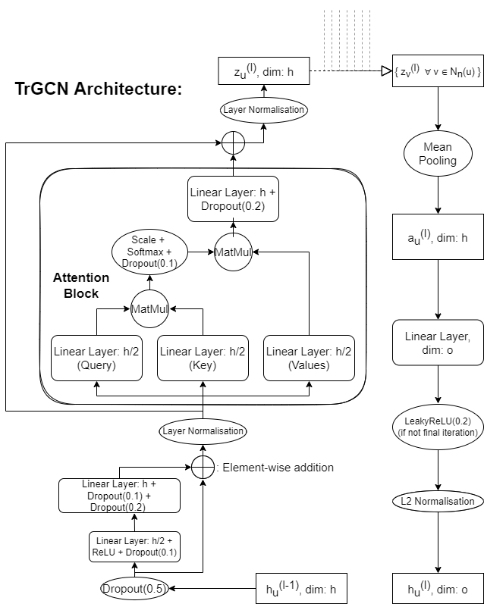
Word-embeddings
Notes:
Our QNetwork is composed of a convolutional stack leading into an LSTM followed up a dueling architecture of noisy linear layers.
This network takes as an input a stack of 4 gray scale frames taken directly from super mario bros alongside the previous action reward, and outputs a q-value estimate for each possible action from the current state.

Slide 28
The Deliverables
Notes:
The project itself will be evaluated using a list of deliverables assessing the agent’s skill, generalizability, memory and speed, alongside the understanding gained and demonstrated during the project itself.

Slide 29
Deliverables:
To explore and develop a deep understanding of the field of ZSL;
Re-create and have a working implementation of ZSL-KG [5];
Implement a simpler baseline model to compare with;
Notes:
Firstly we have three skill-based deliverables, which assess the agents ability to complete difficult levels.
For deliverable one we train test and evaluate the agent on a training set consisting of a singular level.
In this setting, the agent is allowed to over fit to the training set with no regularization whatsoever.
This assesses the agents maximum skill, and is akin to the learning conditions of a player when attempting to speed run a particular level, as they do not need to concentrate on performing well on and learning all other levels simultaneously.

Slide 30
Deliverables:
✓
To explore and develop a deep understanding of the field of ZSL;
Re-create and have a working implementation of ZSL-KG [5];
Implement a simpler baseline model to compare with;
✓
✓
Notes:
Firstly we have three skill-based deliverables, which assess the agents ability to complete difficult levels.
For deliverable one we train test and evaluate the agent on a training set consisting of a singular level.
In this setting, the agent is allowed to over fit to the training set with no regularization whatsoever.
This assesses the agents maximum skill, and is akin to the learning conditions of a player when attempting to speed run a particular level, as they do not need to concentrate on performing well on and learning all other levels simultaneously.

Slide 31
Deliverables:
Improve upon the results of ZSL-KG in the Animals with Attributes 2 (AWA2) benchmark by proposing a new variant of the framework, namely ZSL-KG+;
Notes:
Firstly we have three skill-based deliverables, which assess the agents ability to complete difficult levels.
For deliverable one we train test and evaluate the agent on a training set consisting of a singular level.
In this setting, the agent is allowed to over fit to the training set with no regularization whatsoever.
This assesses the agents maximum skill, and is akin to the learning conditions of a player when attempting to speed run a particular level, as they do not need to concentrate on performing well on and learning all other levels simultaneously.

Slide 32
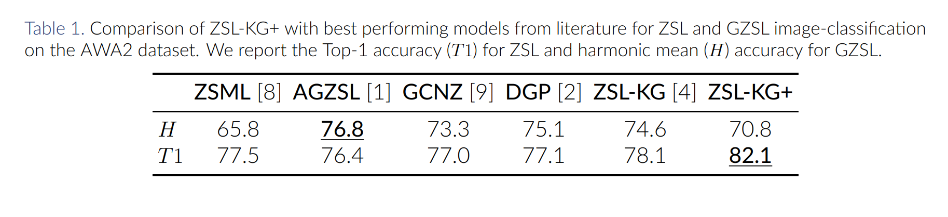
Deliverables:
Improve upon the results of ZSL-KG in the Animals with Attributes 2 (AWA2) benchmark by proposing a new variant of the framework, namely ZSL-KG+;
✓
[11]
[10]
[3]
[4]
[5]
Notes:
Firstly we have three skill-based deliverables, which assess the agents ability to complete difficult levels.
For deliverable one we train test and evaluate the agent on a training set consisting of a singular level.
In this setting, the agent is allowed to over fit to the training set with no regularization whatsoever.
This assesses the agents maximum skill, and is akin to the learning conditions of a player when attempting to speed run a particular level, as they do not need to concentrate on performing well on and learning all other levels simultaneously.

Slide 33
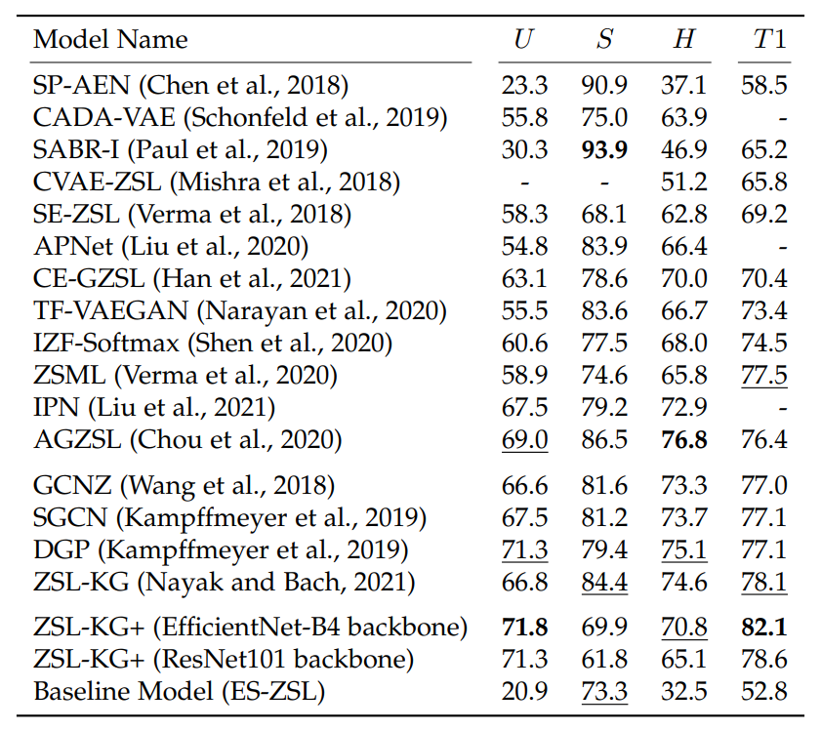
Deliverables:
Improve upon the results of ZSL-KG in the Animals with Attributes 2 (AWA2) benchmark by proposing a new variant of the framework, namely ZSL-KG+;
✓
Notes:
Firstly we have three skill-based deliverables, which assess the agents ability to complete difficult levels.
For deliverable one we train test and evaluate the agent on a training set consisting of a singular level.
In this setting, the agent is allowed to over fit to the training set with no regularization whatsoever.
This assesses the agents maximum skill, and is akin to the learning conditions of a player when attempting to speed run a particular level, as they do not need to concentrate on performing well on and learning all other levels simultaneously.

Slide 34
Deliverables:
Develop a novel method of encompassing class-attribute data into the ZSL-KG+ framework;
Ablate the performance of ZSL-KG+ to develop and show an understanding of which constituent parts and auxiliary data-sources are important for the model and ZSL more generally;
Develop a live front-end graphical user interface to act as an interactive demo and learning resource for newcomers to the field and experts alike.
Notes:
Firstly we have three skill-based deliverables, which assess the agents ability to complete difficult levels.
For deliverable one we train test and evaluate the agent on a training set consisting of a singular level.
In this setting, the agent is allowed to over fit to the training set with no regularization whatsoever.
This assesses the agents maximum skill, and is akin to the learning conditions of a player when attempting to speed run a particular level, as they do not need to concentrate on performing well on and learning all other levels simultaneously.

Slide 35
Deliverables:
Develop a novel method of encompassing class-attribute data into the ZSL-KG+ framework;
Ablate the performance of ZSL-KG+ to develop and show an understanding of which constituent parts and auxiliary data-sources are important for the model and ZSL more generally;
Develop a live front-end graphical user interface to act as an interactive demo and learning resource for newcomers to the field and experts alike.
✗
Notes:
Firstly we have three skill-based deliverables, which assess the agents ability to complete difficult levels.
For deliverable one we train test and evaluate the agent on a training set consisting of a singular level.
In this setting, the agent is allowed to over fit to the training set with no regularization whatsoever.
This assesses the agents maximum skill, and is akin to the learning conditions of a player when attempting to speed run a particular level, as they do not need to concentrate on performing well on and learning all other levels simultaneously.

Slide 36
Deliverables:
Develop a novel method of encompassing class-attribute data into the ZSL-KG+ framework;
Ablate the performance of ZSL-KG+ to develop and show an understanding of which constituent parts and auxiliary data-sources are important for the model and ZSL more generally;
Develop a live front-end graphical user interface to act as an interactive demo and learning resource for newcomers to the field and experts alike.
✗
✓
Notes:
Firstly we have three skill-based deliverables, which assess the agents ability to complete difficult levels.
For deliverable one we train test and evaluate the agent on a training set consisting of a singular level.
In this setting, the agent is allowed to over fit to the training set with no regularization whatsoever.
This assesses the agents maximum skill, and is akin to the learning conditions of a player when attempting to speed run a particular level, as they do not need to concentrate on performing well on and learning all other levels simultaneously.

Slide 37
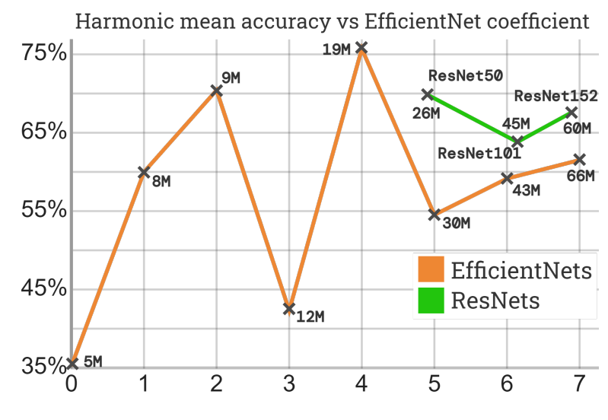
Ablation Studies:

Slide 38
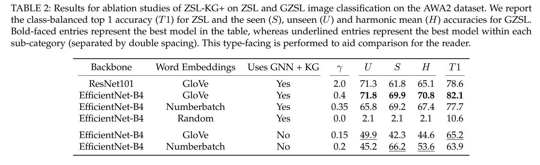
Ablation Studies:

Slide 39
Deliverables:
Develop a novel method of encompassing class-attribute data into the ZSL-KG+ framework;
Ablate the performance of ZSL-KG+ to develop and show an understanding of which constituent parts and auxiliary data-sources are important for the model and ZSL more generally;
Develop a live front-end graphical user interface to act as an interactive demo and learning resource for newcomers to the field and experts alike.
✗
✓
Notes:
Firstly we have three skill-based deliverables, which assess the agents ability to complete difficult levels.
For deliverable one we train test and evaluate the agent on a training set consisting of a singular level.
In this setting, the agent is allowed to over fit to the training set with no regularization whatsoever.
This assesses the agents maximum skill, and is akin to the learning conditions of a player when attempting to speed run a particular level, as they do not need to concentrate on performing well on and learning all other levels simultaneously.

Slide 40
Deliverables:
Develop a novel method of encompassing class-attribute data into the ZSL-KG+ framework;
Ablate the performance of ZSL-KG+ to develop and show an understanding of which constituent parts and auxiliary data-sources are important for the model and ZSL more generally;
Develop a live front-end graphical user interface to act as an interactive demo and learning resource for newcomers to the field and experts alike.
✗
✓
✓
Notes:
Firstly we have three skill-based deliverables, which assess the agents ability to complete difficult levels.
For deliverable one we train test and evaluate the agent on a training set consisting of a singular level.
In this setting, the agent is allowed to over fit to the training set with no regularization whatsoever.
This assesses the agents maximum skill, and is akin to the learning conditions of a player when attempting to speed run a particular level, as they do not need to concentrate on performing well on and learning all other levels simultaneously.

Slide 41
Live front-end framework demo
Notes:
The project itself will be evaluated using a list of deliverables assessing the agent’s skill, generalizability, memory and speed, alongside the understanding gained and demonstrated during the project itself.

Slide 42
Conclusion
We propose an improved framework, ZSL-KG+, which we evaluate on the AWA2 benchmark.
ZSL-KG+ improves the Top-1 accuracy from 78.1% to 82.1% in the ZSL setting, while achieving a reduction of 58% in model-parameters and a 35% decrease in prediction-time.
Furthermore, we introduced an interactive ZSL demo framework, and ablated our model in ways not found in literature.
?
Thanks for listening!
Notes:
Overall, this makes ZSL-KG+ ideal for low-budget time-critical real-world deployments.
Thank you for listening!
Feel free to ask any questions you may have and i will do my best to answer them!

Slide 43
References
Kipf, T. N. and Welling, M. (2016), ‘Semi-supervised classification with graph convolutional networks’, arXiv preprint arXiv:1609.02907 .
Miller, G. A. (1995), ‘Wordnet: a lexical database for english’, Communications of the ACM 38(11), 39–41.
Wang, X., Ye, Y. and Gupta, A. (2018), Zero-shot recognition via semantic embeddings and knowledge graphs, in ‘Proceedings of the IEEE conference on computer vision and pattern recognition’, pp. 6857– 6866.
Kampffmeyer, M. et al. (2019), Rethinking knowledge graph propagation for zero-shot learning, in ‘Proceedings of the IEEE/CVF Conference on Computer Vision and Pattern Recognition’, pp. 11487–11
Nayak, N. V. and Bach, S. H. (2021), ‘Zero-shot learning with common sense knowledge graphs’.
He, K., Zhang, X., Ren, S. and Sun, J. (2016), Deep residual learning for image recognition, in ‘Proceedings of the IEEE conference on computer vision and pattern recognition’, pp. 770–778.
Tan, M. and Le, Q. (2019), Efficientnet: Rethinking model scaling for convolutional neural networks, in ‘International conference on machine learning’, PMLR, pp. 6105–6114.
Speer, R., Chin, J. and Havasi, C. (2017), Conceptnet 5.5: An open multilingual graph of general knowledge, in ‘Thirty-first AAAI conference on artificial intelligence’.
Selvaraju, R. R. et al. (2017), Grad-cam: Visual explanations from deep networks via gradient-based localization, in ‘Proceedings of the IEEE international conference on computer vision’, pp. 618–626.
Chou, Y.-Y., Lin, H.-T. and Liu, T.-L. (2020), Adaptive and generative zero-shot learning, in ‘International Conference on Learning Representations’.
Verma, V. K., Brahma, D. and Rai, P. (2020), Meta-learning for generalized zero-shot learning, in ‘Proceedings of the AAAI Conference on Artificial Intelligence’, Vol. 34, pp. 6062–6069.

